Slide 1
Module 4 Attacks and Defenses
Section 2 – Offline Attacks
June 2018

Slide 2
Agenda
Boot from media
Offline Password Cracking
Countermeasures
Documentation
Quiz

Slide 3
.
Section 2 – Offline Attacks
Learning Objectives
Explain offline attacks
Boot from media
Offline Password Cracking
Identify countermeasures

Slide 4
Boot from media

Slide 5
Booting an alternative operating system
1
2
3
A custom, alternative OS may boot and record memory
values instead of overwriting them
Alternative OS may be quite small, overwriting very little memory
Alternative OSes may be delivered via a wide variety of
methods: USB, floppy, network …

Slide 6
Goal of Boot from media
Install a new operating system
If your PC won't start and you haven't created a recovery drive, download installation media and use it to restore from a system restore point or reset your PC.
If needing to access the registry database on a system that is no longer bootable

Slide 7
From an attacker perspective
The goal is to gain administrator access with a Windows Boot DVD/USB for following versions :
Windows Vista
Windows 7
Windows 8 Pro
Windows 10
Windows Server 2008/2008 R2
Windows Server 2012 / 2012R2
Windows Server 2016
Required physical access to computer
A Windows 7 DVD can be used to gain administrator access to Windows 10 and vice versa.
The methods only work for local accounts not Microsoft account.
Disk that contains the operating system should not be encrypted

Slide 8
Boot from media - Step by step

Slide 9
Goal
Present how an attacker could boot the computer from a media and take control of the local administrator account

Slide 10

Boot from media
You may need to change your system BIOS
to start from the boot media.
Insert the CD/DVD / USB boot media.
Start computer to boot from the
CD/DVD/USB.
Press any key to boot from other media.
Key

Slide 11
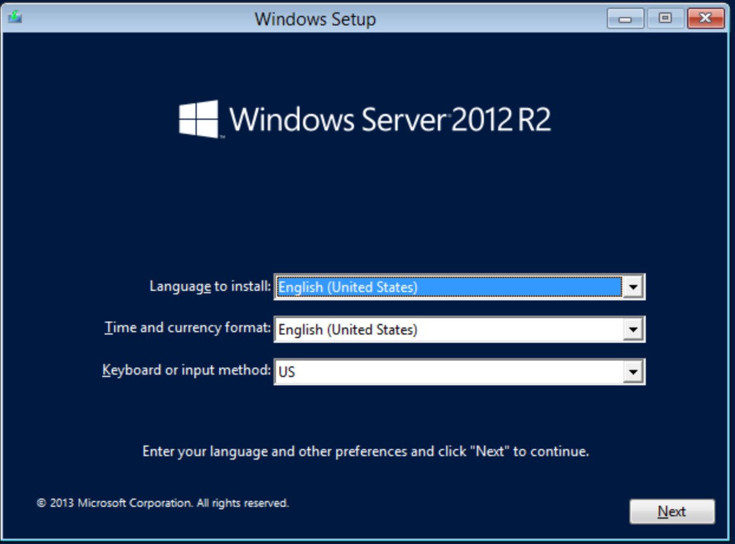
Select Language
Enter your language and other preferences
And click “Next” to continue.
Key

Slide 12
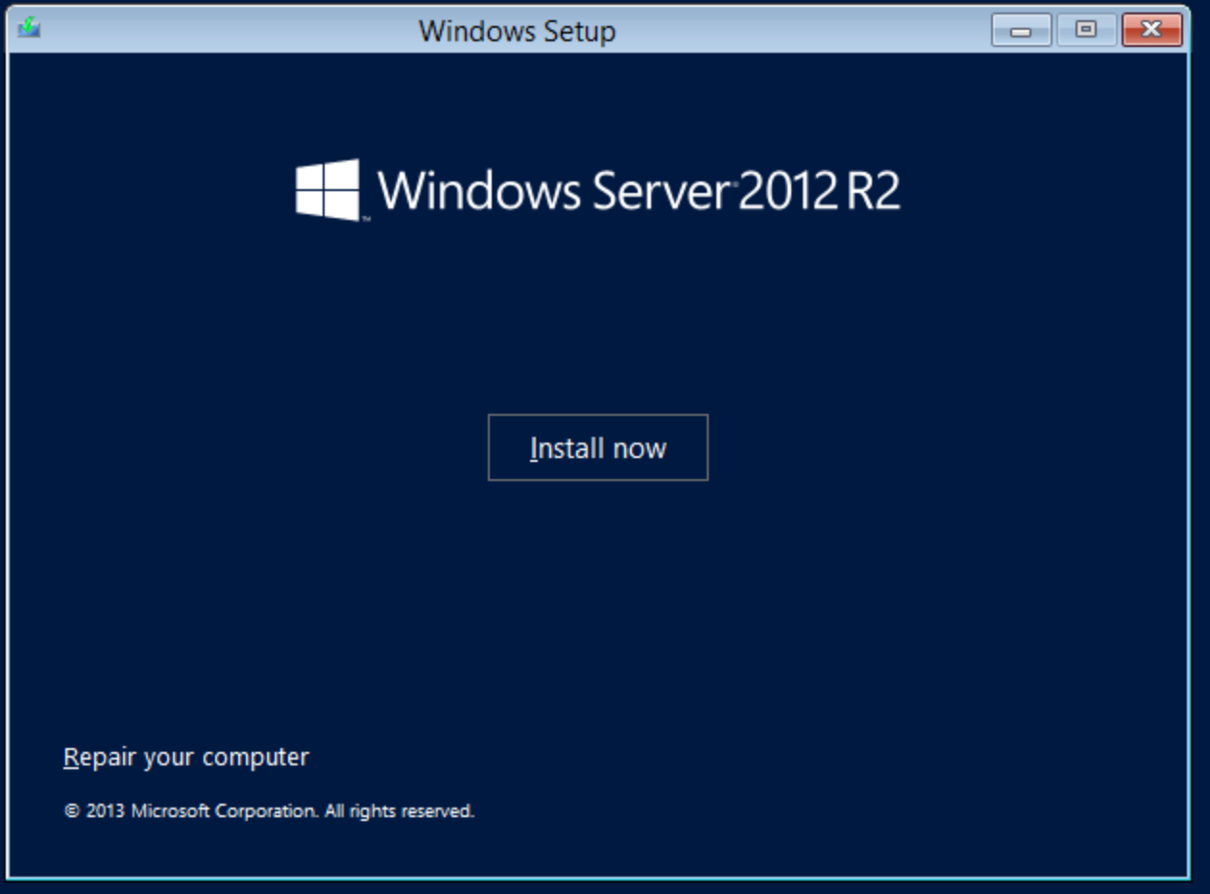
Keyboard Sticky
press [Shift] [F10] simultaneously five times
Key

Slide 13
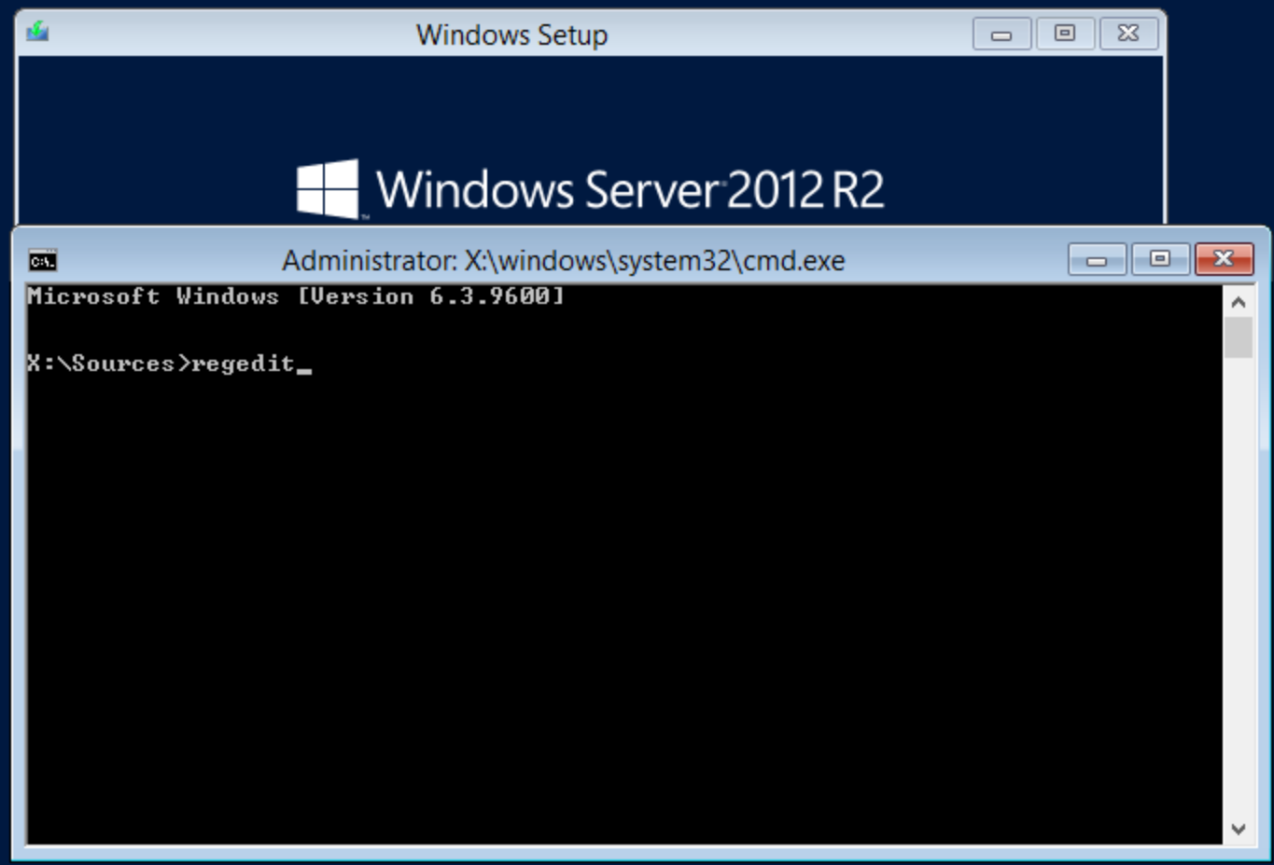
Regedit
The registry editor will allow us to modify
the normal operation of an executable;
we will replace it with the execution of the
command line.
Only a certain number of applications are
executable during a normal logon. The
function of the sticky keys, the virtual
keyboard and more generally ergonomic
management applications are. In our
example, we will replace the operation of
the sticky keys of the target computer by the
execution of the command line.
Key

Slide 14
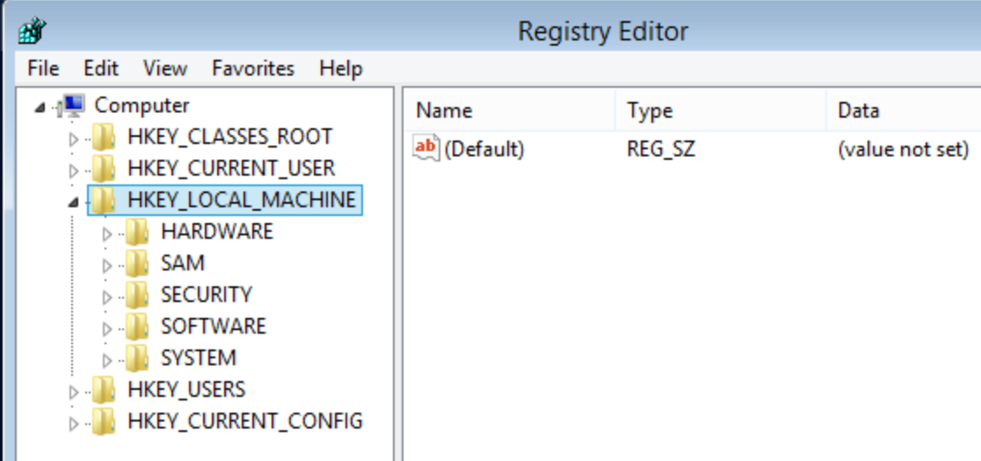
HKLM
Click on HKEY_LOCAL_MACHINE
Key

Slide 15
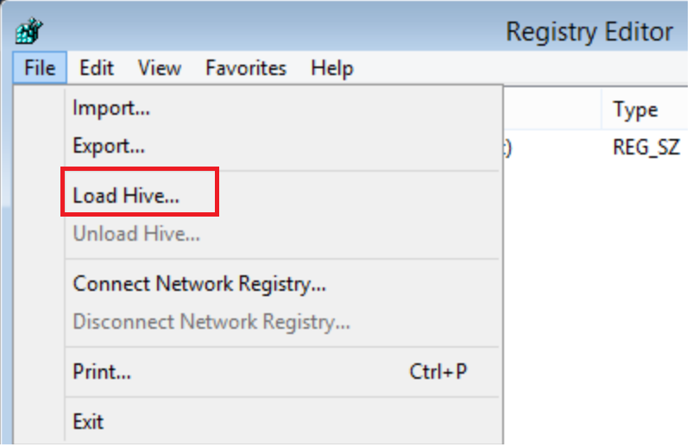
Load Hive
Click on “Load Hive”
Key

Slide 16
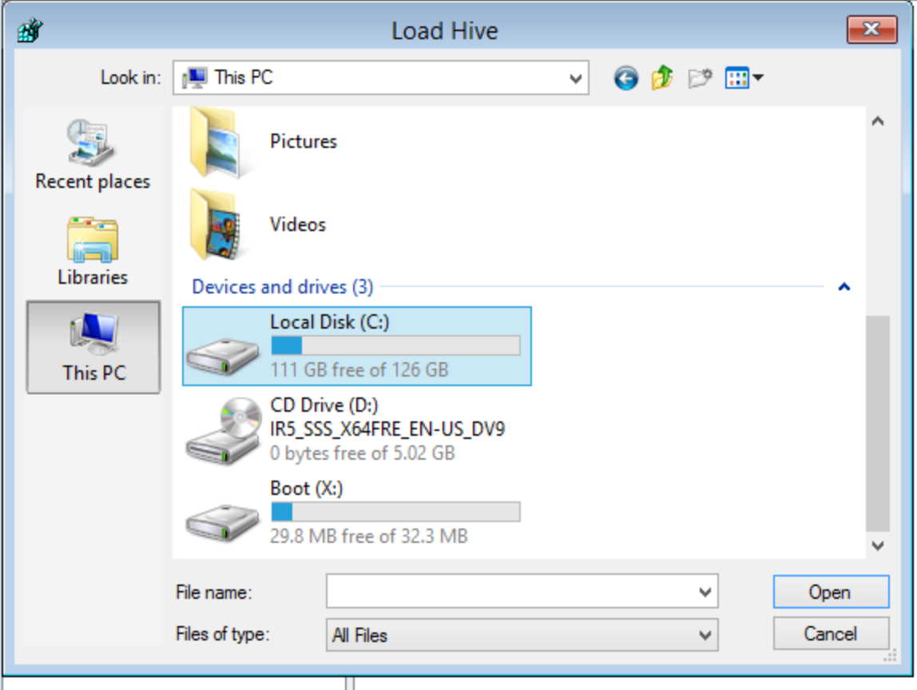
Load File
In our example, The register file to be loaded
is located on the C: disk. The drive letter may
differ on other machines. It’s depend on which
drives operating system was installed.
Key

Slide 17
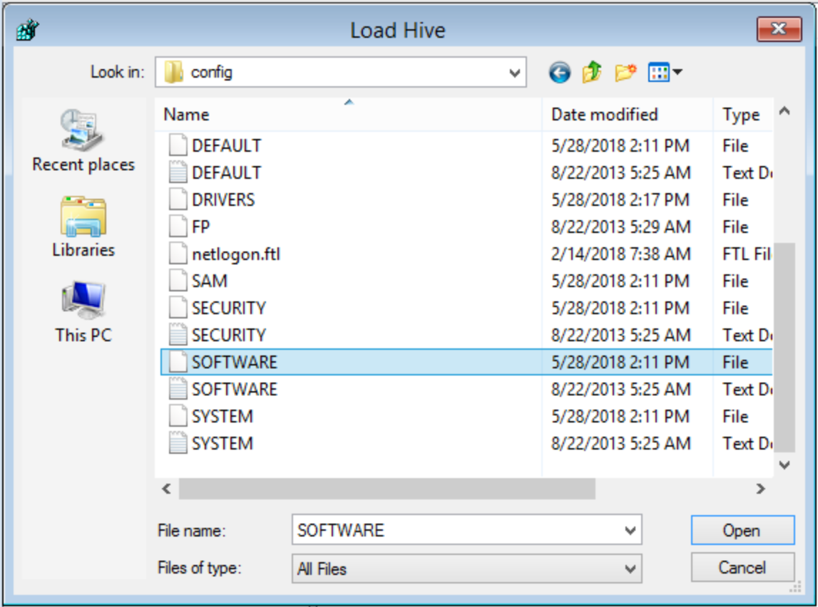
Load File
Select C:\Windows\System32\config\Software
Key

Slide 18
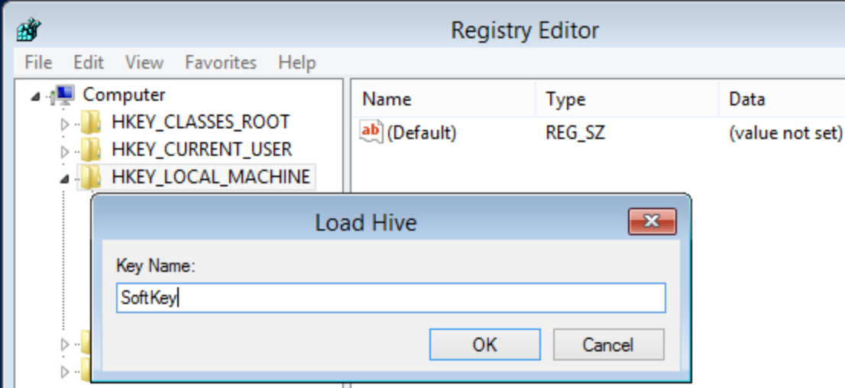
Key Name
Enter a Key Name.
Key

Slide 19
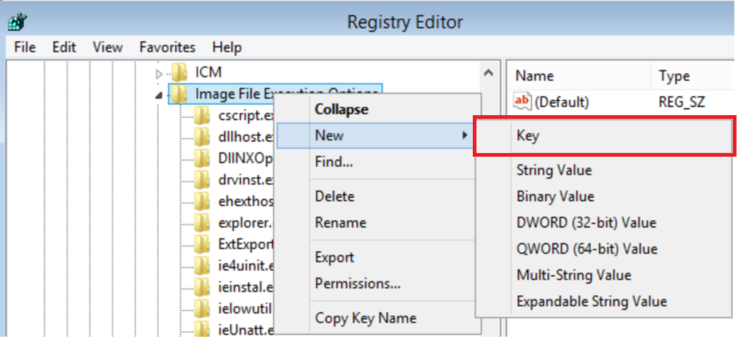
Create a new Key
From imported key, navigate to “Softkey\Microsoft\
Windows NT\Current Version\
Image File Execution Options\” and create a
new key. Name it “Sethc.exe”
Key

Slide 20
What is Sethc.exe ?
1
2
3
Tool that invokes the Windows disability mode so that users can press key combinations such as Ctrl+A successively rather than simultaneously
It has no effect whatsoever on user accounts and passwords
Executable which resides in the Windows\System32 directory. If you swap the Sethc.exe file with something else like cmd.exe, you have access to the command prompt running SYSTEM privileges. SYSTEM is an

Slide 21
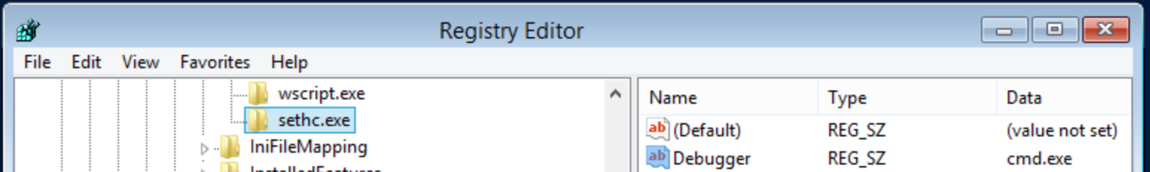
cmd.exe
Add a string value with the name Debugger.
Give this new entry the value cmd.exe.
Key

Slide 22
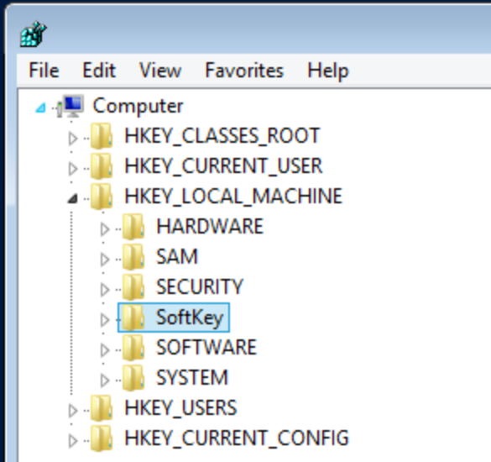
SoftKey
It is important to unload the Soft hive properly
for the changes take effect when the system
reboots.
Reduce all keys to the “SoftKey” root key that
should be selected as in the following image
Key

Slide 23
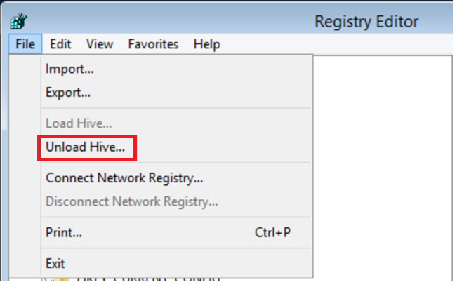
Unload Hive
Click on “Unload Hive…”
Key

Slide 24
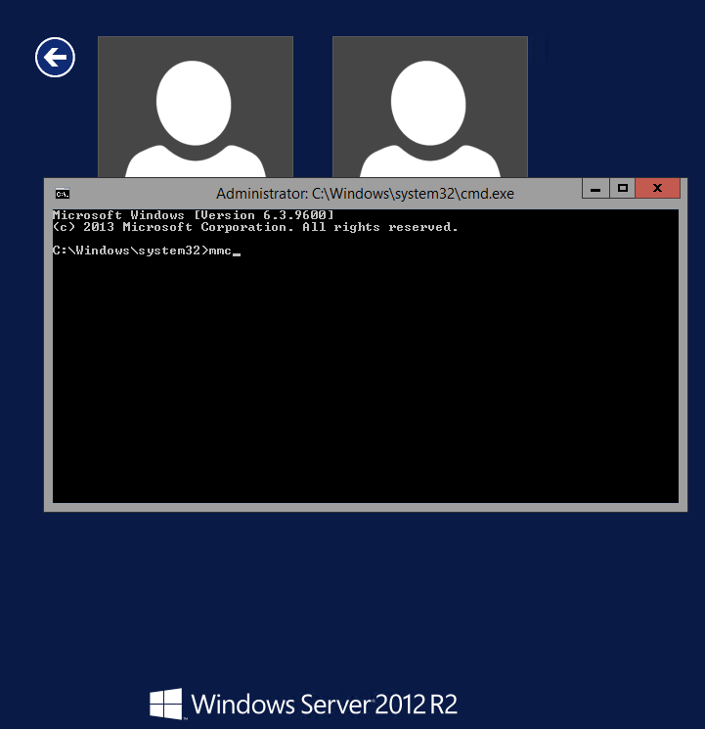
Restart computer
You can now close the registry editor and
restart your laptop normally. We replaced the
normal operation of sticky keys by starting
the command line.
After reboot, press [Shift] simultaneously
five times.
It is now possible to start applications, but
some, like the control panel, which needs the
Windows desktop, will not work. We will run
the MMC that will allow us to manage users,
change a password, or add an existing user to
the local administrator group
Key

Slide 25
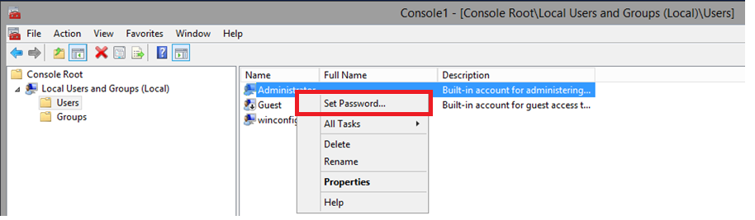
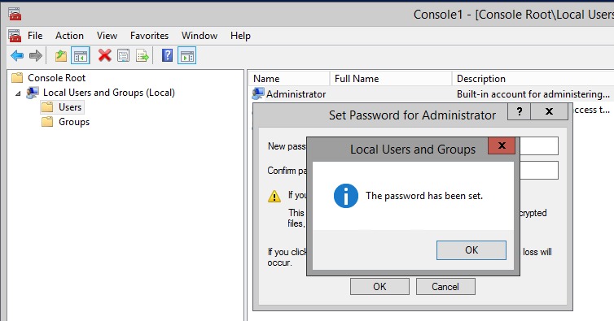
Set password for administrator account
Open the Local Users and groups (Local)
console, and on Users container, set a password
for Administrator account and confirm.
Key

Slide 26
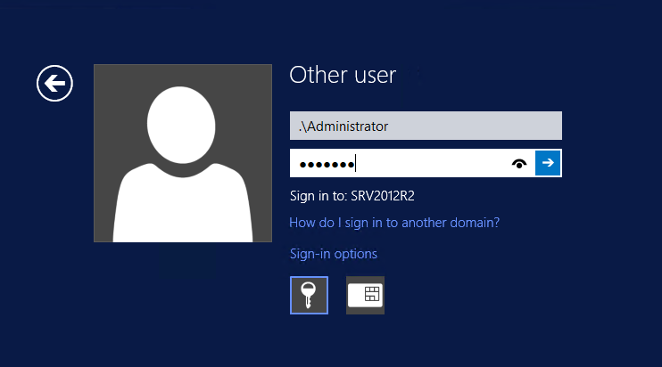
Log in with Administrator account
Now, use Administrator account to open a
session
Key

Slide 27
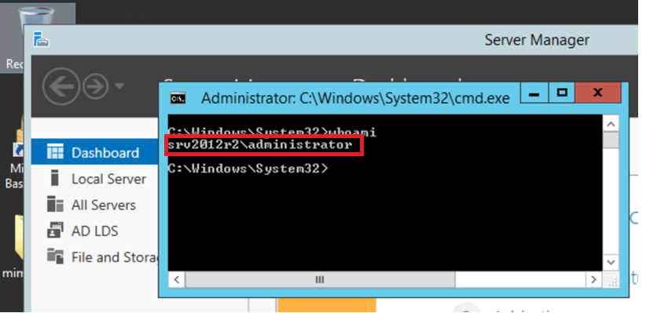
Logged with Administrator account
Now, use Administrator account to open a
session
Key

Slide 28
Offline Password cracking

Slide 29
Offline password cracking
1
2
3
Possible when you have access to the
password hash(es).
The attack is done on your own system or
on systems that you have local access too. Unlike an online attack, there are no locks or anything else to stop you on an offline attack because you are doing it on your own machines.
The only thing that could hold you back is the limits of your
computer hardware because an offline attack takes advantage of
its machine’s processing power and its speed is dependent on
the speed of the actual machine.

Slide 30
Password cracking techniques
Dictionary
Brute force
Rainbow table
Fingerprint
Permutation
Hybrid

Slide 31
Most popular password cracking tools
Cain and Abel
John the Ripper
OphCrack
L0phtCrack
RainbowCrack
Hybrid

Slide 32
Windows Password
Windows user account passwords are typically stored in SAM hive of the registry (which corresponds to %SystemRoot%\system32\config\SAM file), in the SAM file the password is kept encrypted using the LMHash or NTLM hash.
In an attempt to improve the security of the SAM database against offline software cracking, the SAM file is further encrypted with the SysKey (Windows 2000 and above) which is stored in %SystemRoot%\system32\config\system file. During the boot-time of Windows the hashes from the SAM file gets decrypted using the SysKey and the hashes are loaded to the registry is then used for authentication purpose.

Slide 33
Video - Demo Crack the Hash (see WindowsSecurity-Module4-Section2-Offline-Attacks-CrackTheHash.wmv)

Slide 34
Countermeasures

Slide 35
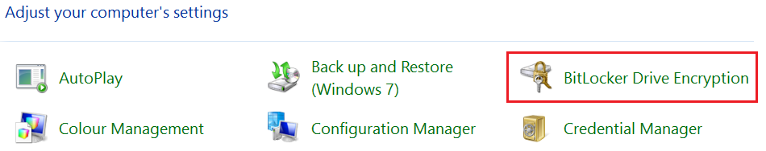
What is BitLocker?
BitLocker Drive Encryption (BDE) is a data protection feature that provides encryption for entire volumes
BitLocker is meant to prevent offline attacks (lost, stolen laptop)
Not meant to protect from online attacks (can be combined with Encrypting File System (EFS))
Can provide Integrity checking of early boot components and Pre-boot Authentication
You can find it in the Control Panel

Slide 36
Bitlocker and AES
By default, BitLocker uses Advanced Encryption Standard (AES) with a 128-bit key
AES key for Bitlocker is either 128-bits or 256-bits
The block size is always a multiple of 16 bytes
By default, in Windows 7, BitLocker uses AES in CBC (Cipher Block Chaining) mode with Diffuser (removed since Windows 8)
AES was established by the U.S. National Institute of Standards and Technology (NIST) in 2001
Notes:
https://en.wikipedia.org/wiki/Block_cipher_mode_of_operation
[EDITOR] Divya
20th November 2014
Kindly confirm if content must be updated for Elephant Diffuser.

Slide 37
BitLocker History

Slide 38
Encryption
Bitlocker encrypts each sector on the drive separately
Each sector in the volume is encrypted individually, with a part of the encryption key being derived from the sector number itself. This means that two sectors containing identical unencrypted data will result in different encrypted bytes
Each sector is encrypted by key called FVEK (Full Volume Encryption Key) which is stored encrypted by VMK (Volume Master Key) on the disk alongside with disk metadata.
Encryption is single threaded process while decryption is a multithreaded process
Disk must be at least 64 MB in size
Bad sectors (marked by chkdsk) are not encrypted

Slide 39
Encryption Keys
Bitlocker uses hierarchy of different keys:
Operating System Volume contains:
Encrypted Operating System
Encrypted Page File
Encrypted Temp Files
Encrypted Data
Encrypted Hibernation File
SRK – Storage Root Key
VMK – Volume Master Key
FVEK – Full Volume Encryption Key

Slide 40
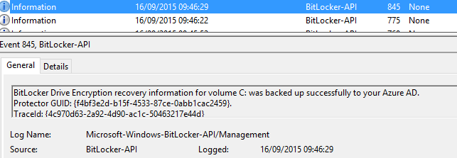
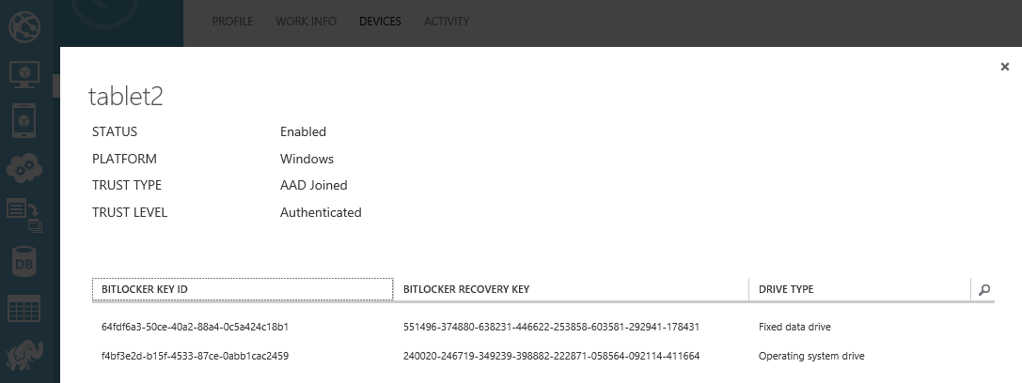
Bitlocker Integration with Azure
Windows 10 can automatically export Bitlocker Recovery Password after joining to Azure AD
Event ID 845 will be logged as confirmation
Keys can be retrieved from Azure Portal

Slide 41
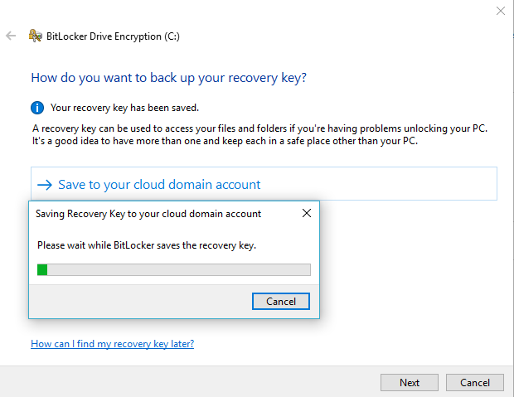
Bitlocker Integration with Azure
Added option to save Bitlocker recovery Password to the cloud

Slide 42
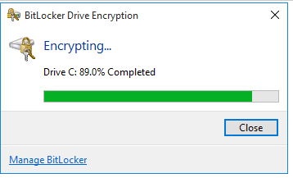
Can I Work While BitLocker is Encrypting My Drives?
Yes, but the Performance will be impacted
The time to fully encrypt the hard disk does not depend on the used space as BitLocker works block wise
BitLocker will continue even if you run out of power, and the machine goes into hibernation or sleep mode and if computer shuts down
It might happen on Win7/Win8 that file data written to the drive will land on “non provisioned” sector and will not be protected (until encryption reaches 100%)
On Win10 every write operation on the drive encrypts the affected sector

Slide 43
Things to Be Considered While Creating a Password
Set the minimum password length to 14 characters
Force users to change their passwords periodically
Uniqueness
Upper & Lower case
Make it difficult to crack
Do not use known things to people about yourself like birthdate
Dictionary words are not to be used
Do not use key strokes adjacent to each other like “1234”, etc.

Slide 44
Other practices
Use BIOS / UEFI password to protect boot order
Use a laptop cable lock
Disable LM password hashes
Rename highly privileged accounts
Don’t reuse the same password within password changes
Enable security auditing to help monitor and track password attacks

Slide 45
Documentation

Slide 46
Ressources
Bitlocker Overview
Microsoft Password Guidance
ANSSI - Bitlocker Overview
Privileged Access Workstation

Slide 47
.
Section 2 – Offline Attacks
Summary
Boot from media
Offline Password Cracking

